Slide 1
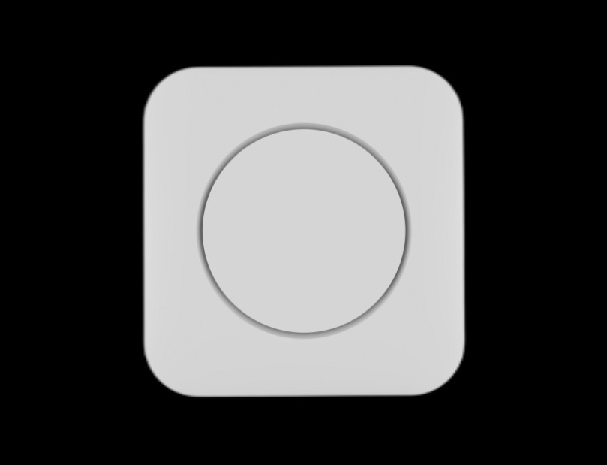
Datasheet|BE5100 Dual Band 2.5G Uplink Wi-Fi7 Ceiling AP
FR-WA22GEP-5100C1
Description
FR-WA22GEP-5100C1 supports ieee802.11be standard and is downward compatible with ieee802.11ax/ac/n/g/b/a, providing wireless data transmission rate up to 5.1gbps, with the characteristics of fast speed, low delay, large capacity, more security and more power saving. Compared with the previous generation of Wi Fi, the connection rate and the total network capacity are greatly improved. Network delay, channel interference is reduced, data transmission efficiency and connection security are improved. In today's high-density, high congestion network environment, game delay is lower, 4K video experience is smoother, more suitable for a large number of smart home devices access. And support ceiling mounted design, very suitable for enterprises, hotels, airports, schools and other indoor or public places to achieve high-speed network coverage. At the same time, the product supports 802.3at standard power supply, which enables the AP to be installed even without AC power supply, reduces the installation cost, makes the installation and use more concise, convenient and flexible, and improves the traditional network layout.
Major features
Support 802.11be
High speed data rate up to 5100Mbps
1*2.5G Uplink LAN Port(1*RJ45)，1*Gigabilt dowinlink LAN Port
Support MLO、MRU and Puncturing
5*3dBi PCB Omnidirectional Antennas
Work temperature from 0 to 40℃
Supports up to 256 users for access (recommended concurrent access terminals: 60)
HUNAN FULLRIVER HIGH TECHNOLOGY CO.，LTD
Notes:
V 1.00 initial version

Slide 2
Specification
Model | FR-WA22GEP-5100C1
Chipset | AN7563PT+MT7991AV+MT7976CN+EN8811H
CPU | Dual Core 1.0GHz
RAM | 512MByte(DDR3)
ROM | 128MByte(SPI NAND Flash)
External FEM | No External FEM
Indicator | SYS
Port | 1*10/100/1000/2500Mbps LAN Port(RJ45) 1*10/100/1000Mbps LAN Port(RJ45) 1*DC Jack
Button | 1*Reset
Antenna | 2*2.4G 3dBi PCB antennas, 3*5G 3dBi PCB antennas
Power Supply | 802.3at/af 12V DC in
Dimension | 225*220*42mm
Installation | Ceiling
ESD | IEC61000-4-2, Level 3: Contact discharge: ±4kV, Air discharge: ±8kV
Surge | IEC61000-4-5, Common Mode 2kV
Temperature | Work：0~40℃ Storage：-40~70℃
Humidty | Work：10%~90% (RH non-condensing) Storage：5%~95% (RH without non-condensing)
HUNAN FULLRIVER HIGH TECHNOLOGY CO.，LTD
HUNAN FULLRIVER HIGH TECHNOLOGY CO.，LTD

Slide 3
Specification
Protocal | 5GHz:IEEE 802.11be,IEEE 802.11ax,IEEE 802.11ac,IEEE 802.11n,IEEE 802.11a 2.4GHz:IEEE 802.11be,IEEE 802.11ax,IEEE 802.11ac,IEEE 802.11n,IEEE 802.11g,IEEE 802.11b
Work Band | 2.4GHz & 5GHz
Wi-Fi Speed | 2.4GHz: Up to 689Mbps (2T2R) 5GHz: Up to 4325Mbps (3T3R)
Modulation | IEEE 802.11b:CCK, QPSK, BPSK IEEE 802.11g/a:OFDM IEEE 802.11n:QPSK, BPSK, 16QAM, 64QAM IEEE 802.11ac:BPSK, QPSK, 16QAM, 64QAM, 256QAM IEEE 802.11ax:BPSK, QPSK, 16QAM, 64QAM, 256QAM, 1024QAM IEEE 802.11be:BPSK, QPSK, 16QAM, 64QAM, 256QAM, 1024QAM, 4096QAM
2.4G | Mode | Rate | Power(dBm)
 | 802.11b | 1M | 23±2dBm
 |  | 11M | 23±2dBm
 | 802.11g | 6M | 22±2dBm
 |  | 54M | 20±2dBm
 | 802.11n HT20 | MCS0 | 21±2dBm
 |  | MCS7 | 18.5±2dBm
 | 802.11n HT40 | MCS0 | 21±2dBm
 |  | MCS7 | 18.5±2dBm
 | 802.11ax HE-SU20 | MCS0 | 20.5±2dBm
 |  | MCS11 | 17±2dBm
 | 802.11ax HE-SU40 | MCS0 | 20.5±2dBm
 |  | MCS11 | 17±2dBm
 | 802.11be EHT20 | MCS0 | 20.5±2dBm
 |  | MCS13 | 16±2dBm
 | 802.11be EHT40 | MCS0 | 20.5±2dBm
 |  | MCS13 | 16±2dBm
5G | Mode | Rate | Power(dBm)
 | 802.11a | 6M | 22±2dBm
 |  | 54M | 20±2dBm
 | 802.11n HT20 | MCS0 | 21±2dBm
 |  | MCS7 | 18.5±2dBm
 | 802.11n HT40 | MCS0 | 21±2dBm
 |  | MCS7 | 18.5±2dBm
 | 802.11ac VHT20 | MCS0 | 20.5±2dBm
 |  | MCS8 | 18±2dBm
 | 802.11ac VHT40 | MCS0 | 20.5±2dBm
 |  | MCS9 | 18±2dBm
 | 802.11ac VHT80 | MCS0 | 20±2dBm
 |  | MCS9 | 17.5±2dBm
 | 802.11ac VHT160 | MCS0 | 18.5±2dBm
 |  | MCS9 | 16±2dBm
HUNAN FULLRIVER HIGH TECHNOLOGY CO.，LTD
HUNAN FULLRIVER HIGH TECHNOLOGY CO.，LTD

Slide 4
Specification
 | 802.11ax HE-SU20 | MCS0 | 20.5±2dBm
 |  | MCS11 | 17±2dBm
 | 802.11ax HE-SU40 | MCS0 | 20.5±2dBm
 |  | MCS11 | 17±2dBm
 | 802.11ax HE-SU80 | MCS0 | 20±2dBm
 |  | MCS11 | 16.5±2dBm
 | 802.11ax HE-SU160 | MCS0 | 18.5±2dBm
 |  | MCS1 | 15.5±2dBm
 | 802.11be EHT20 | MCS0 | 20.5±2dBm
 |  | MCS13 | 15.5±2dBm
 | 802.11be EHT40 | MCS0 | 20.5±2dBm
 |  | MCS13 | 15.5±2dBm
 | 802.11be EHT80 | MCS0 | 205±2dBm
 |  | MCS13 | 15±2dBm
 | 802.11be EHT160 | MCS0 | 18.5±2dBm
 |  | MCS13 | 13±2dBm
2.4G | Mode | Rate | RX Sensitivity(dBm)
 | 802.11b | 1M | ≤-97dBm
 |  | 11M | ≤-89dBm
 | 802.11g | 6M | ≤-94dBm
 |  | 54M | ≤-76dBm
 | 802.11n HT20 | MCS0 | ≤-94dBm
 |  | MCS7 | ≤-75dBm
 | 802.11n HT40 | MCS0 | ≤-91dBm
 |  | MCS7 | ≤-72dBm
 | 802.11ax HE-SU20 | MCS0 | ≤-94dBm
 |  | MCS11 | ≤-65dBm
 | 802.11ax HE-SU40 | MCS0 | ≤-92dBm
 |  | MCS11 | ≤-61dBm
 | 802.11be EHT20 | MCS0 | ≤-94dBm
 |  | MCS13 | ≤-58dBm
 | 802.11be EHT40 | MCS0 | ≤-91dBm
 |  | MCS13 | ≤-56dBm
HUNAN FULLRIVER HIGH TECHNOLOGY CO.，LTD
HUNAN FULLRIVER HIGH TECHNOLOGY CO.，LTD

Slide 5
Specification
5G | Mode | Rate | RX Sensitivity(dBm)
 | 802.11a | 6M | ≤-94dBm
 |  | 54M | ≤-76dBm
 | 802.11n HT20 | MCS0 | ≤-93dBm
 |  | MCS7 | ≤-69dBm
 | 802.11n HT40 | MCS0 | ≤-90dBm
 |  | MCS7 | ≤-67dBm
 | 802.11ac VHT20 | MCS0 | ≤-93dBm
 |  | MCS8 | ≤-69dBm
 | 802.11ac VHT40 | MCS0 | ≤-90dBm
 |  | MCS9 | ≤-66dBm
 | 802.11ac VHT80 | MCS0 | ≤-87dBm
 |  | MCS9 | ≤-61dBm
 | 802.11ac VHT160 | MCS0 | ≤-84dBm
 |  | MCS9 | ≤-58dBm
 | 802.11ax HE-SU20 | MCS0 | ≤-93dBm
 |  | MCS11 | ≤-64dBm
 | 802.11ax HE-SU40 | MCS0 | ≤-91dBm
 |  | MCS11 | ≤-61dBm
 | 802.11ax HE-SU80 | MCS0 | ≤-88dBm
 |  | MCS11 | ≤-58dBm
 | 802.11ax HE-SU160 | MCS0 | ≤-85dBm
 |  | MCS1 | ≤-55dBm
 | 802.11be EHT20 | MCS0 | ≤-93dBm
 |  | MCS13 | ≤-57dBm
 | 802.11be EHT40 | MCS0 | ≤-91dBm
 |  | MCS13 | ≤-54.5dBm
 | 802.11be EHT80 | MCS0 | ≤-88dBm
 |  | MCS13 | ≤-51.5dBm
 | 802.11be EHT160 | MCS0 | ≤-85dBm
 |  | MCS13 | ≤-48.5dBm
HUNAN FULLRIVER HIGH TECHNOLOGY CO.，LTD
HUNAN FULLRIVER HIGH TECHNOLOGY CO.，LTD

