Slide 1
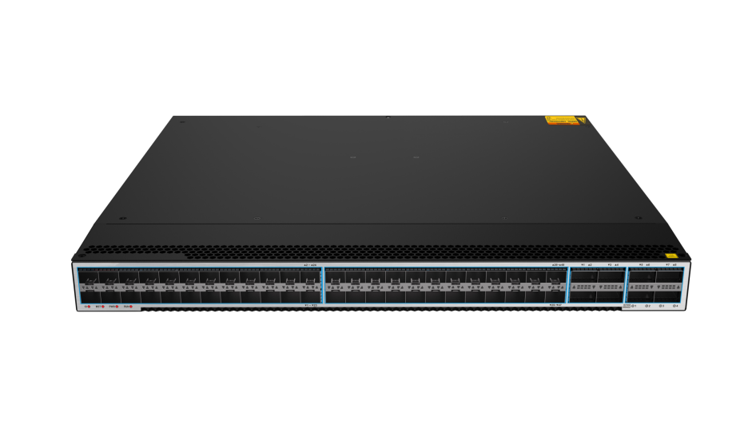
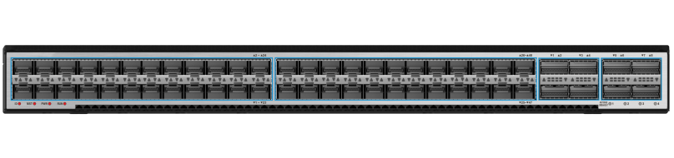
Datacenter Series Switches
FR-S6356YCQ
Product Overview
FR-S6356YCQ is a new generation of high-performance data center full 10 Gigabit TOR switch for high-performance cloud computing, data center and high-end campus network. Adopt advanced hardware architecture design to provide the highest switching performance and rich data center business features in the industry.
FR-S6356YCQ provides high-density 10G/25G/100G data center access. In order to meet the pooling requirements of cloud computing data center network resources, it supports rich data center features such as VXLAN, EVPN, M-LAG, Stack, NETCONF and so on.
Meet the data center network construction requirements and data center internal layer 2 network deployment requirements.
Product Appearance
FR-S6900-48S8CQ | 48×25GE SFP28 8×40/100GE QSFP28 2×hot-swapped fans 1+1 power redundancy
HUNAN FULLRIVER HIGH TECHNOLOGY CO.LTD.
Notes:
V 1.00 initial version

Slide 2
Features and Benefits
High Reliability
Provides enhanced Ethernet reliability technologies such as STP/RSTP/MSTP,
Flink at millisecond-level protection switchover, as well as LB(loopback check) to ensure link-level reliability.
Support 1+1 redundant hot swappable power supply and an AC power supply and a DC power can be used simultaneously. Moreover, the switch supports fault detection and alarms for power modules and fan, fan speed can be automatically adjusted according to temperature variations.
High Switching Capacity
The backplane capacity of FR-S6356YCQ is up to 4T to provide all ports with non-stop forwarding. The FR-S6356YCQ high performance makes sure to build a reliable, sustainable high speed IP networks.
FR-S6356YCQ provided high density 10/25/40/100GE port. It can meet the high density, high bandwidth access and aggregation application scenarios of data center and campus network.
Powerful Services Support
FR-S6356YCQ supports IGMP snooping, IGMP proxy, IGMP filter, and IGMP fast leave for robust multicast. It offers wire-speed replication of multicast packets between VLANs, and multicast load balancing among trunk member interfaces to meet requirements for IPTV services and other multicast services.
Superior Quality of Service
FR-S6356YCQ offers Gigabit Ethernet with intelligent services that keep everything flowing smoothly with mechanisms for marking, classification, and scheduling.
It supports traffic classification based on abundant criteria such as MAC/IP address, Layer 4 TCP/UDP port number, protocol, port and VLAN.
Each port supports 8 priority queues with multiple queue scheduling algorithms such as SP/PQ, DRR, SP/PQ+DRR , WRED to ensure the highest-priority packets are processed ahead of all other traffic.
Powerful Services Support
FR-S6356YCQ offers a comprehensive security solution by providing service security in three aspects: subscriber, switch and network.
Subscriber security helps create protections among customers with multiple features. DHCP Snooping, ARP Inspection, and IP Source Guard help to identify each customer based on MAC, IP address and port information to help prevent malicious attack.
Switch security means CPU can be protected from DoS attack and storm. The port security feature allows controlling the number of MAC addresses against overwhelming the switch memory.
Network security is to filter all incoming traffic for ensuring only valid traffic passing through by applying different ACL rules and IEEE 802.1x authentication prevents insecure terminals to intrude illegally into the entire network.
HUNAN FULLRIVER HIGH TECHNOLOGY CO.LTD.

Slide 3
Products Specifications
Features | FR-S6356YCQ
Ports | 48×10/25GE SFP288×40/100GE QSFP28
Throughput | 2000Mpps
Switching capacity | 4Tbps
VLAN | 4K VLANs; 1:1 & 2:2 VLAN Mapping; QinQ, selective QinQ; MAC based VLAN; Protocols based VLANGuest VLAN; Voice VLAN;MVRP
Port trunk | LACP; 32 trunk groups at most, up to 8 ports in each group
MAC | 128K MAC; Static MAC; Dynamic MAC;
IPv4 routing | Static routing; OSPF;RIP;ISIS;BGP;ECMP; PBR;FRR
IPv6 routing | Static routing; OSPFv3;RIPng;ISISv6;BGP4+;ECMP; PBR;FRR
IPv4 Multicast | IGMP; IGMP snooping; IGMP Proxy; PIM-SM; PIM-DM; PIM-SSM; MSDP;DVMRP
IPv6 Multicast | MLD; MLD-Snooping; IPv6 PIM-DM; IPv6 PIM-SM; IPv6 PIM-SSM
Reliability | STP, RSTP, MSTP, ERPS, FLink protection, VRRP/VRRPv3, Trunk, Redundancy powerBPDU Guard, Loop protection, Root protection;
QoS/ACL | Packet filtering at Layer 2 to Layer 4, filtering out invalid frames based on source MAC address, destination MAC address, source IP address, destination IP address, TCP/UDP port number, protocol type and VLAN ID
 | Time range ACL
 | Rate limiting with granularity at 64Kbps
 | Port-based traffic policing and two-rate three-color CAR
 | Re-marking of the 802.1p priority and DSCP priority
Security | User privilege management and password protection
 | DoS attack defense, ARP attack defense, IP source guard
 | Binding of the IP address, MAC address, interface
 | Port isolation, Port security
 | 802.1x authentication, RADIUS authentication
 | SSH v2.0
 | CPU protection
Data Center feature | EVPN,VXLAN,M-Lag,Stack
Energy saving | Dynamic fan speed adjusting
HUNAN FULLRIVER HIGH TECHNOLOGY CO.LTD.

Slide 4
Products Specifications
Management & maintenance | Port mirroring and Flow-based mirroring
 | Configuration via CLI, Telnet, Console port
 | SNMP v1/v2/v3, RMON, LLDP, Cluster network, Syslog, Traplog
 | Third-Party GUI management platform based on SNMP
 | Loading and upgrade via FTP、TFTP
 | Port loopback detection
Operating environment | Operation temperature: 0℃ to 40℃Relative humidity:10%-90% (non-condensing)
Input voltage | AC: Rated voltage range:100V to 240V AC, 50/60Hz
 | DC: Rated voltage range: -40V to -57V DC
Dimensions(W×D×H）mm | 440×400×44
Power consumption | ≤180W
Weight(GW) | <9 kg
HUNAN FULLRIVER HIGH TECHNOLOGY CO.LTD.

