Slide 1
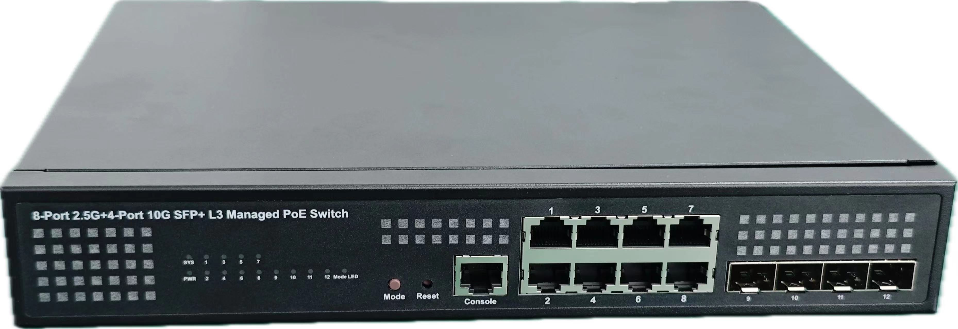
Datasheet|8 2.5G +4 SFP+ L3 Managed PoE Switch
FR-S5112ET-240HP5
Description
FR-S5112ET-240HP5 is a L3 managed 10G PoE switch. Provides eight 10/100/1000/2500Mbps self-adaption RJ45 port, plus four 10 gigabit SFP+ optical port, it can be used to link bandwidth higher upstream equipment.
Support Open flow, OSPFv3 and other core functions, hardware support high-speed exchange of dual-stack information, meet the network transition from campus IPV4 to IPV6, address capacity and network security are greatly improved. Adopt enterprise high reliability design, rich software function, flexible management mode, suitable for SMB, medium and large campus network and security application.
FR-S5112ET-240HP5 has PoE power supply function on all 8 ports and supports IEEE802.3bt standard, and ports 1 -8 support IEEE802.3bt. It can be used as a power over Ethernet device. It can automatically detect and identify powered equipment that meets the standard, and power it through the network cable.
Features
Supports IEEE 802.3i 、IEEE802.3af、IEEE802.3at、IEEE802.3bt、IEEE 802.3u 、IEEE802.3z、IEEE802.3ab、IEEE802.3x、IEEE802.3ae、IEEE802.3az.
The maximum single port power of 1-8 ports POE is 90W, and the maximum total power output is 240W.
Supports MAC address auto-learning and auto-aging.
Store and forward mode operates.
Web-based Management Support.
LED indicators for monitoring power, link/activity,PoE.
11 inches full metal iron shell and internal power adapter design, suitable for rack installation.
湖南恒茂高科股份有限公司
HUNAN FULLRIVER HIGH TECHNOLOGY CO.,LTD.
Notes:
V 1.00 initial version

Slide 2
Specification
Model |  | FR-S5112ET-240HP5
Chipset |  | RTL9313+2*RTL8224N+2*RTL8329
Standards |  | IEEE 802.3i、IEEE 802.3u、IEEE 802.3az、IEEE802.3af、IEEE802.3ae、IEEE802.3at、IEEE802.3bt、IEEE802.3z、IEEE 802.3x
Ports |  | 8 x 10/100/1000/2500Mbps ports 4 x 1000/10000Mbps SFP+ ports 1 x Console port
Network Media(Cable) |  | 10Base-T: UTP category 3, 4, 5 cable (maximum 100m) 100Base-Tx: UTP category 5, 5e cable (maximum 100m) 1000Base-T: UTP category 5e, 6 cable (maximum 100m) 2.5GBase-T: UTP category 5e, 6 cable (maximum 100m) 1000Base-X: MMF,SMF 10GBase-X: MMF,SMF
Transfer Method |  | Store-and-Forward
MAC Address Table |  | 32K
Switching Capacity |  | 120Gbps
Packet Forwarding Rate |  | 89.28Mpps
Packet Buffer |  | 16Mbits
Jumbo Frame |  | 12KBytes
PoE Ports(RJ45) |  | 1-8 ports compliant with 802.3bt/at/af
Power Pin Assignment |  | 1278-/3645+ bt-port
PoE Budget |  | 240W
LED indicators | Per Device | SYS&Mode : Green
 | Per-Port | RJ45/SFP+：Green/Orange
 |  | PoE：Green
Power Supply |  | AC 100~240V, 50/60HZ, 880W internal power
Dimensions（L×W×H） |  | 280*230*44mm
ESD |  | IEC61000-4-2, Level 3: Contact discharge: ±6kV, Air discharge: ±8kV
Surge |  | IEC61000-4-5, RJ45 Common Mode 6kV Power Common Mode 4kV Power Differential mode 2kV
Environment |  | Operating Temperature: 0℃ ~ 45℃ Storage Temperature: -40℃ ~70℃ Operating Humidity: 10%~90% non-condensing Storage humidity: 5%~90% non-condensing
湖南恒茂科股份有限公司
HUNAN FULLRIVER HIGH TECHNOLOGY CO.,LTD.

Slide 3
Software
Port properties | Support system LED、Port configuration、Port statistics Support MTU、DDM
Management and maintenance | Support System information、user management Support SSH Support Telnet-Server、Telnet-Client、Telnet6-Server、Telnet6-Client Support ping、ping6 Support Tracert Support WEB management、SNMP、RMON Support Manage IP restrictions、Manage timeouts、Reboot
VLAN | Support 802.1Q Support vlan-mac、vlan-protocol、vlan-subnet Support QinQ Support vlan-swap、vlan-translate
Forwarding control | Support Mac address management Support flow-control、BandWidth-Control、DLF-Control、SLF-Control、ErrorPacket-Control
Mirror | Support mirror、remote_mirror
security features | Support Port isolation、storm-control Support MUSER Support ip-source-guard、arp anti-flood、arp anti-spoofing Support Prevent DOS attacks Support Discard-BPDU Support dhcp anti-attack
system reliability | Support LACP、RSTP、MSTP、STP、LBD
DHCP | Support dhcp-snooping、dhcp-server、dhcp-relay、dhcp-client Support option82、option60
L2 multicast | Support IGMP-Snooping Support Static multicast
System alarm | Support syslog、cpu alarm、port alarm
Link detection | Support LLDP
Time management | Support Static state time、SNTP-Client
ARP | Support ARP、ND、ARP-proxy
IPv4 | Support Ordinary VLAN interface、SuperVLAN interface、Loopback interface Support Static routing, Routing strategy Support RIP、OSPF、VRRP Support ip-def-cpu
IPv6 | Support Ordinary VLAN interface、SuperVLAN interface、Loopback interface Support Static route Support RIPng
HUNAN FULLRIVER HIGH TECHNOLOGY CO.,LTD.

